Slide 1
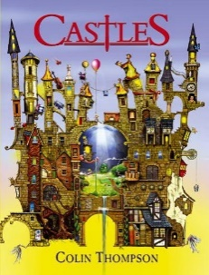
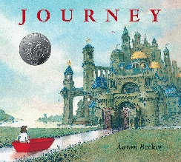
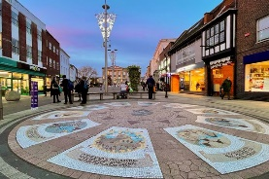
Science
Plant Reproduction – children will learn how a plant reproduces and will be able to name the reproductive parts of a plant. Children will learn and use the word pollination within this. Children will begin to explore how plants have evolved over time to make forming new plants more efficient.
PSHE
Respecting Rights– children will explore what rights are and what it means to respect them.
English
Castles– persuasive brochure.
Journey – narrative.
Children will develop their use of fronted
RE
Hinduism – Hindu festivals (Mahashivrati).
adverbials, technical vocabulary and persuasive language in their writing.
In reading, children will develop their comprehension skills for exploring vocabulary and themes across multiple texts.
Geography – Local Study/Italy
Children will be exploring Italy and the UK as a whole and making comparisons between the two. Children will then make more detailed comparisons between Andover and a town/city in Italy. They will look at similarities and differences in both human and physical geography.
Spring Term 1
Local Study
Where in the world is Andover?
Maths
Children will develop and apply their knowledge of place value, addition and subtraction to measure and increasingly larger numbers (including decimals). They will solve a wide range of problems, using a variety of resources and methods to support them.
Music
The children will explore rhythm and structure. They will begin to record music through rhythmic notation.
Art
Children will develop their sketching and painting skills. They will create a stain-glass design shared through painting and drawing to depict a beautiful place in Andover.
Computing
Children will create programs by planning, modifying, and testing commands to create shapes and patterns, using Logo.
MFL
Children will learn how to say, read and write 10 animals. They will be able to use ‘Je suis’ to identify the correct animal in French.
PE - children will be having swimming lessons in the spring term. We will also be learning skills linked to playing a game of tag rugby.

